Slide 1


Slide 2

Joy and sexual pleasure can be derived from many different things in life. For some, limited sexual experiences is what feels right and brings contentment.
For others, expanding understandings of pleasure to include new interests, like making art, can bring joy.
Whatever it means to you, constructing space for your pleasure should be free of judgment, censorship, or pressure. How do you define pleasure?

Slide 3

Sexual pleasure is the enjoyment and satisfaction resulting from any kind of sexual activity or experience, solitary or partnered. What role does pleasure play in people’s decision to have sex?
People have a right to fulfill, express, and enjoy their sexuality and sexual health within the bounds of respecting others’ sexual rights. What does it mean for people to have a right to their own sexual pleasure?

Slide 4
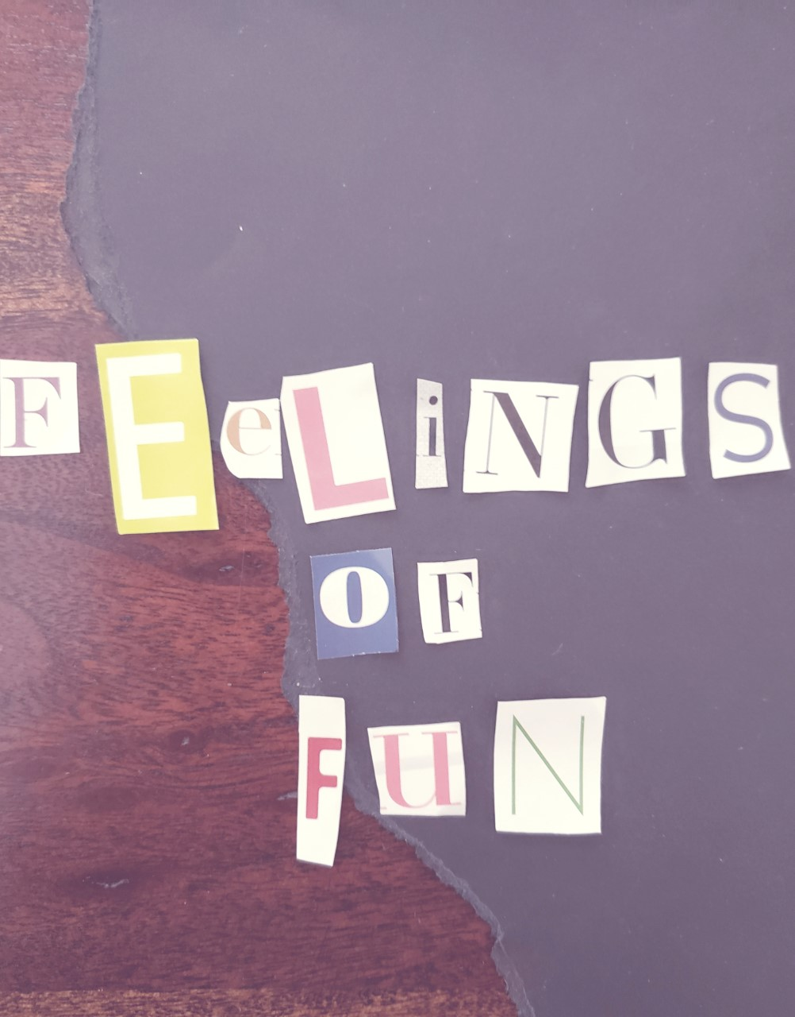
While everyone is entitled to sexual pleasure, you are not entitled to getting it at someone else’s expense. What does this statement mean? How is this tied into consent?
Everyone is allowed and entitled to feelings of pleasure during sex—no matter their body type, identity, or how their body functions. How might pleasure look differently across a diversity of bodies and identities?

Slide 5
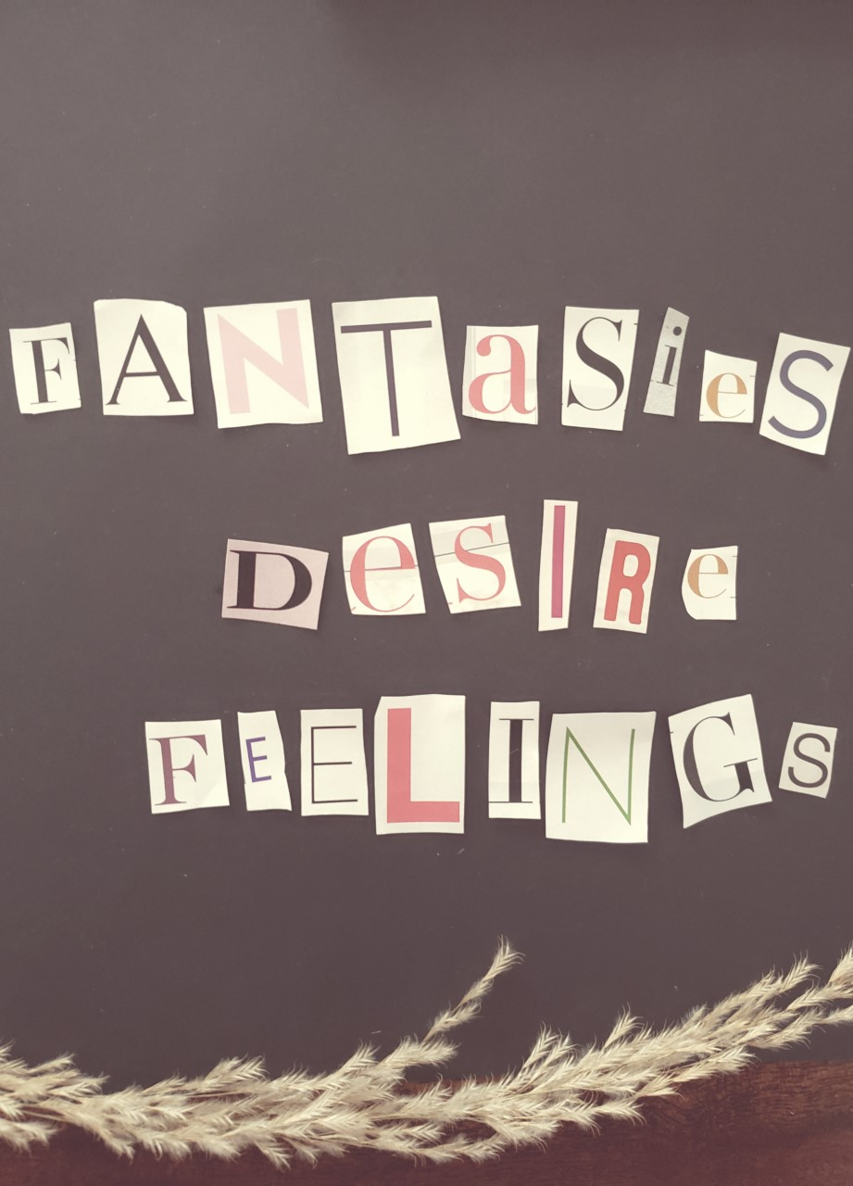
Engaging in sexual behaviors should feel pleasurable and comes with associated responsibilities for one’s health and well-being. How do you know if something feels good to you? How do you know if it feels good to your partner?
People can feel pleasure from physical contact, sexual feelings, fantasies, and desires. People can also feel pleasure physically, emotionally, psychological, and spiritually. How is pleasure derived from sexting, kissing, flirting, masturbation, and viewing pornography different? How is it similar?

Slide 6
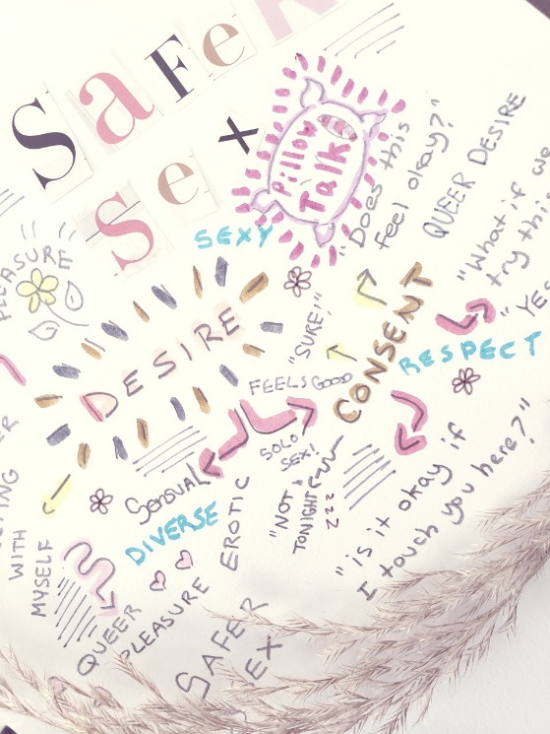
Group Activity
Each group will receive one quote on pleasure.
In your groups, respond to the quote by creating a group mind-map.
Include discussion points, concepts, words, definitions, sentences, questions, other quotes, drawings, cut-outs, and anything else you want.
You will need large sheets of paper, magazines, markers, pencils, and glue.

Slide 7
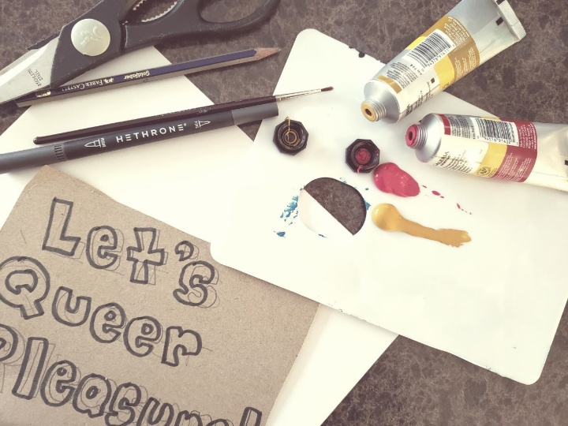
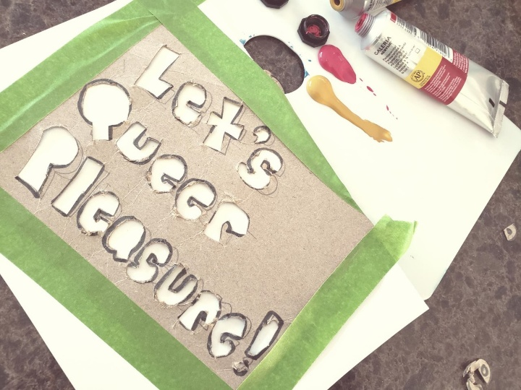
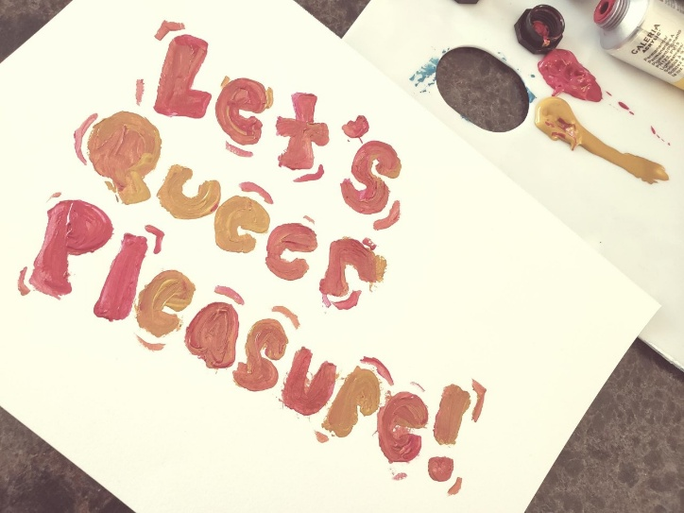
Activity: Stencil-Making
Create a stencil based off one of the following prompts:
- What gives you pleasure?
- What do you wish to tell your school community about pleasure, joy, and desire?
- Why does sexual pleasure matter?
- How is sexual pleasure tied to sexual rights?
- How is sexual pleasure diverse?
Brainstorm ways to turn your prompt response into a simple statement.

