Slide 1

Oral Sex

Slide 2
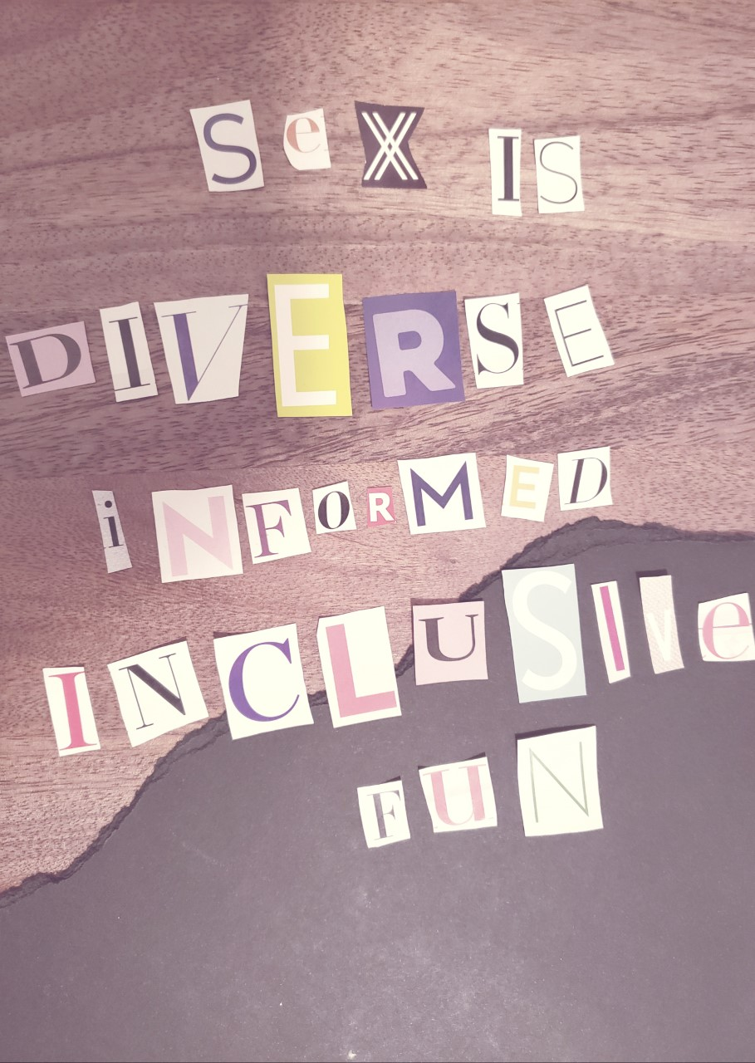
Genital stimulation using the mouth, tongue, teeth, or throat is called oral sex. This can include oral-vulva/clitoris contact (cunnilingus), oral-penile contact (fellatio), and oral-anal contact (anilingus).
Oral sex can give many people physical pleasure and orgasms: The mouth and tongue can be particularly precise and provide pleasant sensations to the person receiving oral sex. For the person giving oral sex, pleasure can be obtained from observing or feeling their partner’s reactions.

Slide 3

Slang terms for oral sex include “giving head”, “blowjobs”, “going down on someone”—some people might use these terms and some people might use others.
What do you think constitutes as “sex”? Does oral sex count as sex? Does penetrative sex count as sex?

Slide 4

Partners can take turns performing oral sex, or they may stimulate each other at the same time.
Oral sex can be practiced in different ways, at different times, as long as consent is present.
Some folks really enjoy oral sex, while others do not enjoy it, or are not comfortable with it—this can also change over time, depending on the person (or not!).
How do you know if your partner is receptive or unreceptive to oral sex?

Slide 5

Oral sex can and does include sex toys, the testicles/scrotum, and stimulating the perineum/taint (the area between one’s genitals and anus) and the anus.

Slide 6
Many STBBIs are transmitted orally, including herpes, gonorrhea, chlamydia, syphilis, and HIV. Remember that condom use during fellatio and dental dam use during cunnilingus can protect you and your partner against STBBIs!
In what ways is using protection during oral sex similar to using protection during penetrative sex? How is it different? Do you think there are stigmas attached to using protective barriers during oral sex?

Slide 7

Contrary to what porn may suggest, not everyone engages in oral sex!
Porn can also give the impression that cunnilingus is the most significant part of foreplay and fellatio is often presented as a form of submission to male desires.
In reality, oral sex should be respectful and egalitarian—it can be done at any time during a sexual interaction, by any person, and can lead directly to an orgasm (or not!).
What boundaries do you need to set for yourself and your partner when engaging in oral sex?

Slide 8

Oral Sex Myth Debunking Activity
Each of your groups will receive an oral sex myth to debunk.
In your groups, write down some initial discussion points before going online and trying to find relevant information to help you debunk the myth!
In your groups, discuss: What makes these statements myths? Is there a better way to ‘write’ these statements as truths? Is there a better way to make these statements more inclusive to all bodies and sexualities?
Be prepared to share your findings with the rest of the class.

